Slide 1
Preserving OpenMalaria experiment with Umbrella
Alex Vyushkov
Haiyan Meng

Slide 2
Malaria disease
Malaria is a life-threatening disease caused by parasites that are transmitted to people through the bites of infected mosquitoes.
In 2015, 95 countries and territories had ongoing malaria transmission.
About 3.2 billion people – almost half of the world’s population – are at risk of malaria.

Slide 3
OpenMalaria model
OpenMalaria is an open source C++ program for simulating malaria epidemiology and the impacts on that epidemiology of interventions against malaria. It is based on microsimulations of malaria parasite in humans, originally developed for simulating malaria vaccines
Development started in 2006
Currently at version 36

Slide 4
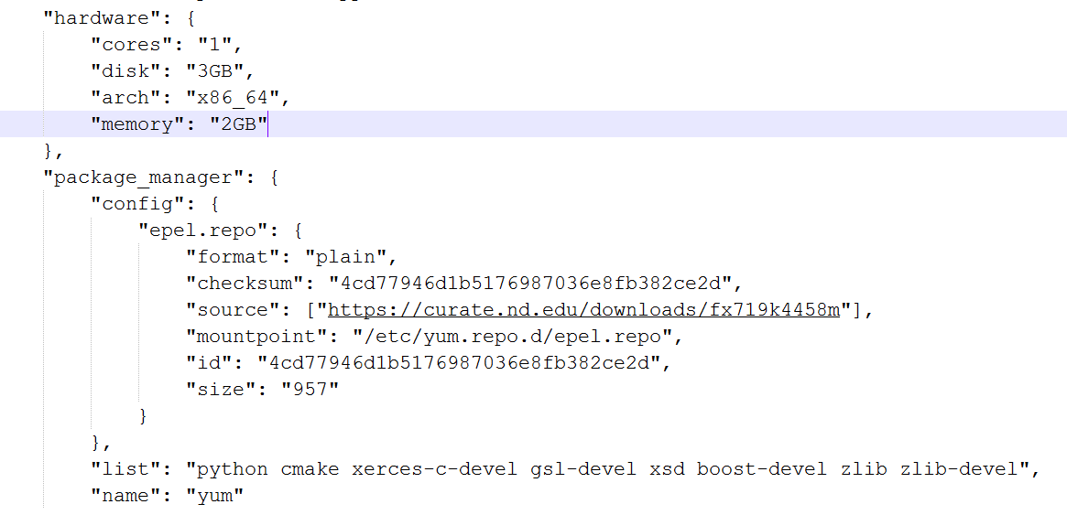
Umbrella specification for OpenMalaria

Slide 5
Umbrella specification for OpenMalaria
Captures execution environment for OpenMalaria program (based on CentOS 6.6)
Specification and all dependencies are preserved in curate.nd.edu (Notre Dame data preservation system)
https://curate.nd.edu/concern/datasets/ff365427s3r

Slide 6
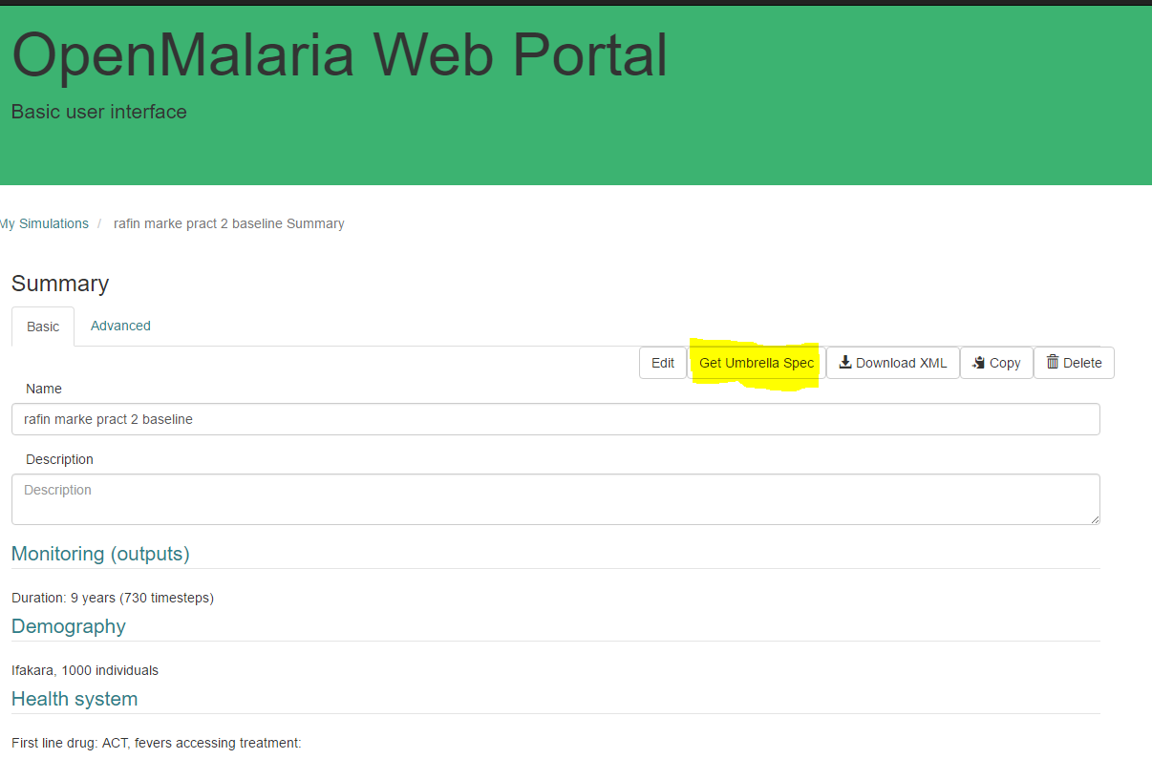
Usage in a web application

